Slide 1
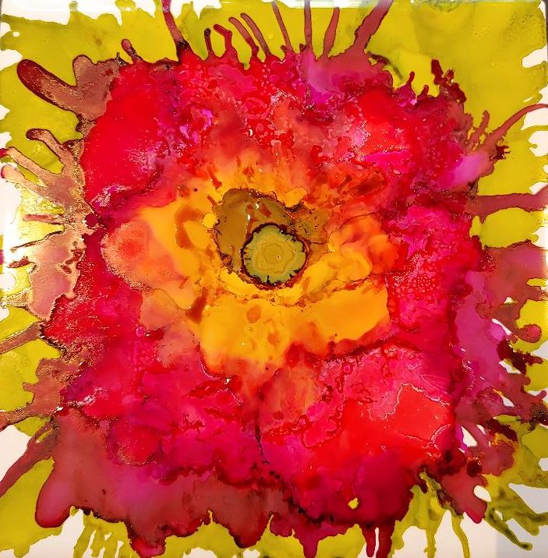
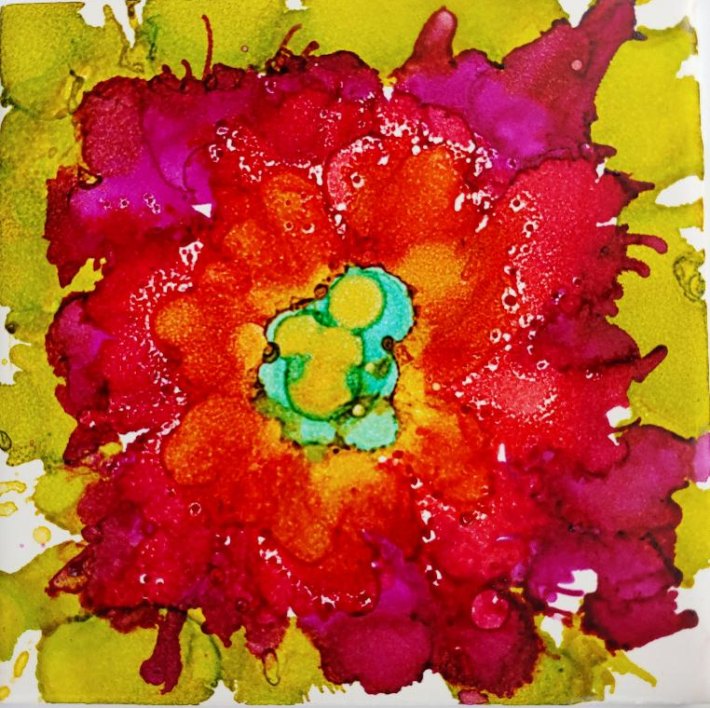
Flower Ink Tiles
Georgia O’keefe

Slide 2
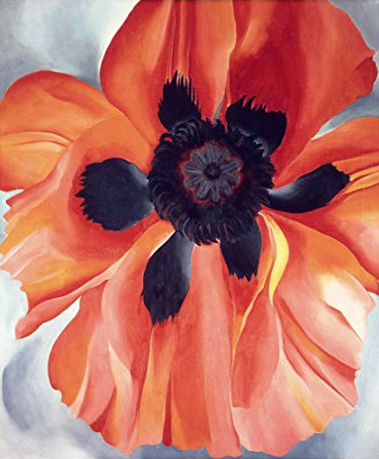
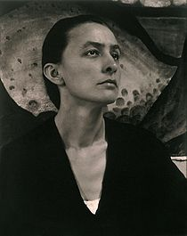
Georgia O’Keefe
Known as the Mother of American Modernism.
As a young art student, she became frustrated with her art lessons, which she felt were too rigid. After two years, she had to leave to work. During that time, she discovered a more fluid style of painting. She loved to focus on flowers, skyscrapers, and the Southwest. She also used amazing colors.

Slide 3
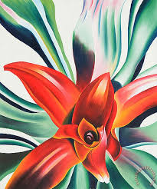
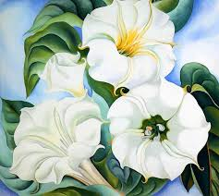
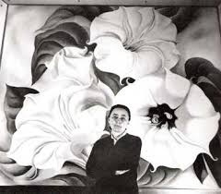
Georgia O’Keefe loved to paint flowers close up. Look how big those flowers are!

Slide 4
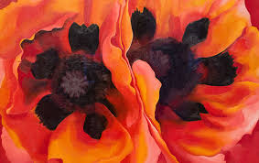
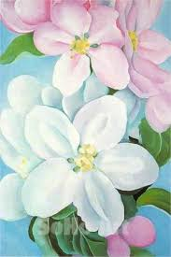
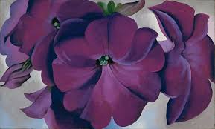
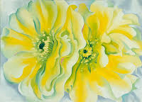

Slide 5
Value
One of the things that makes Georgia O’Keefe’s work so striking is her use of Value. The values help distinguish each flower pedal from another.
Value describes the lightness or darkness of a color.
When a color is darker, we say it is a “Low Value.” When it is lighter, we say it is a “High Value.” In your artwork, it’s good to have Low, Medium, and High Values.

Slide 6
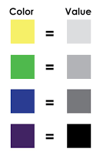
When you use different colors, think about what “Value” they are.
Are they a light, medium, or dark color? Is it a high, medium, or low value?
Using colors that range in lightness and darkness will make your artwork “Pop.” (That means your eye will immediately drawn to it.)

Slide 7
Warm & Cool Colors
Another element that makes O’Keefe’s work engaging for the viewer is a strong use of cool or warm colors.
Color Hues can be divided into warm and cool colors
Warm Colors = Sun or Fire
Can feel dynamic, create appetite and excitement.
Cool Colors = Water or Ice
Can feel relaxed, calming, and bring peaceful feelings.

Slide 8
Flower Ink Tile Coasters

Slide 9
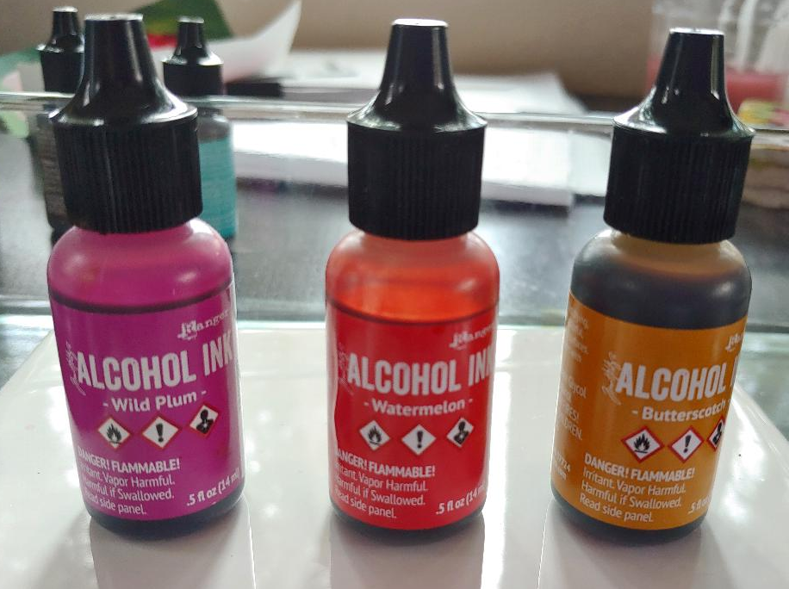
Choose Colors
Pick warm or cool palette.
2. Choose three colors with varying values: Low, Med, High
NOTE: Color will stain, wear gloves & apron if you are concerned about your hands or clothes.
If you go slow and controlled, you should not get ink on yourself. Do not squeeze bottles. Just tilt it slowly with a bit of pressure and you will have just enough ink.

Slide 10
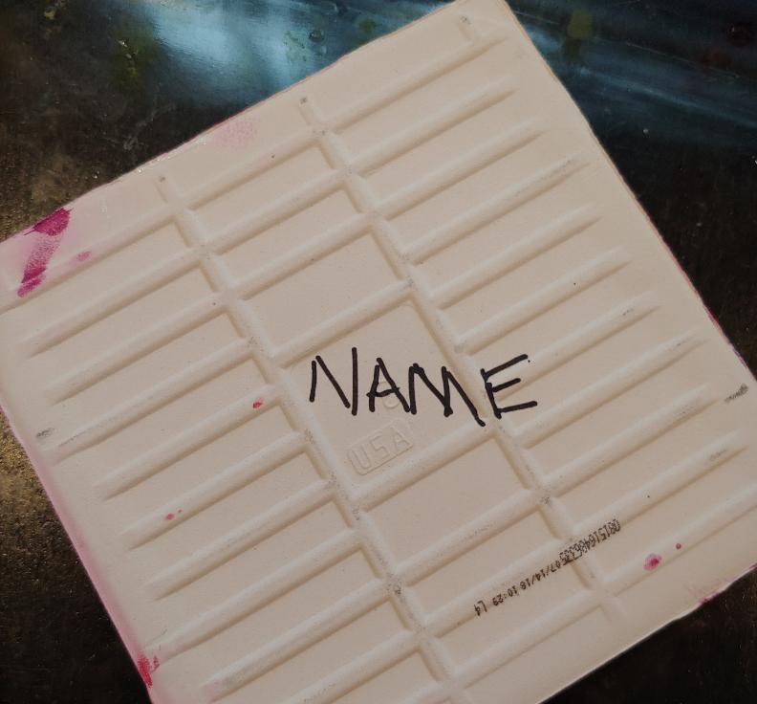
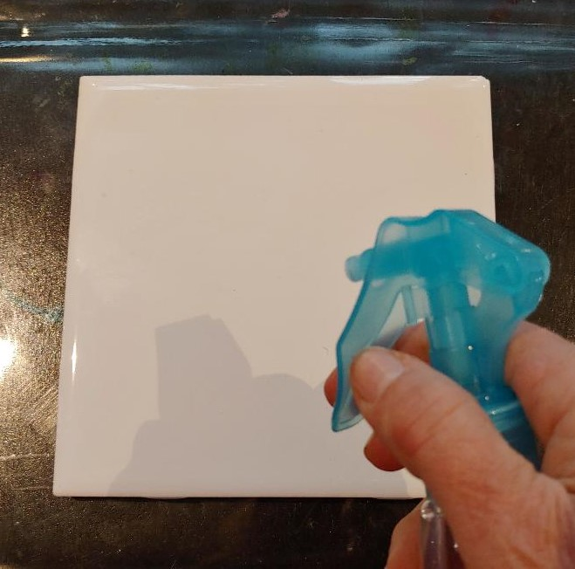
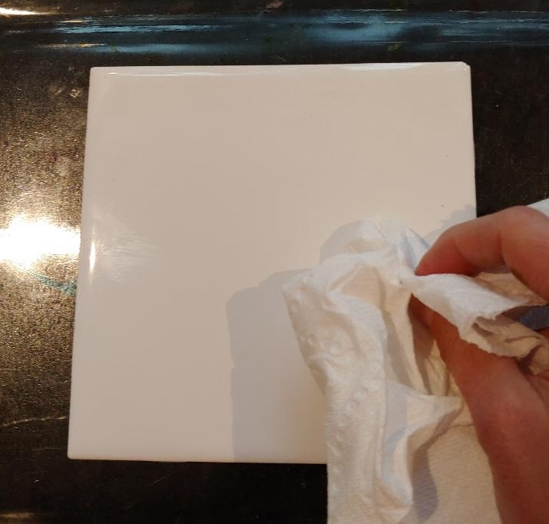
Prepare Your Tile
1. Write you name with a Sharpie on the back and place felt pads at each corner.
2. Spray the tile with isopropyl and wipe off.

Slide 11
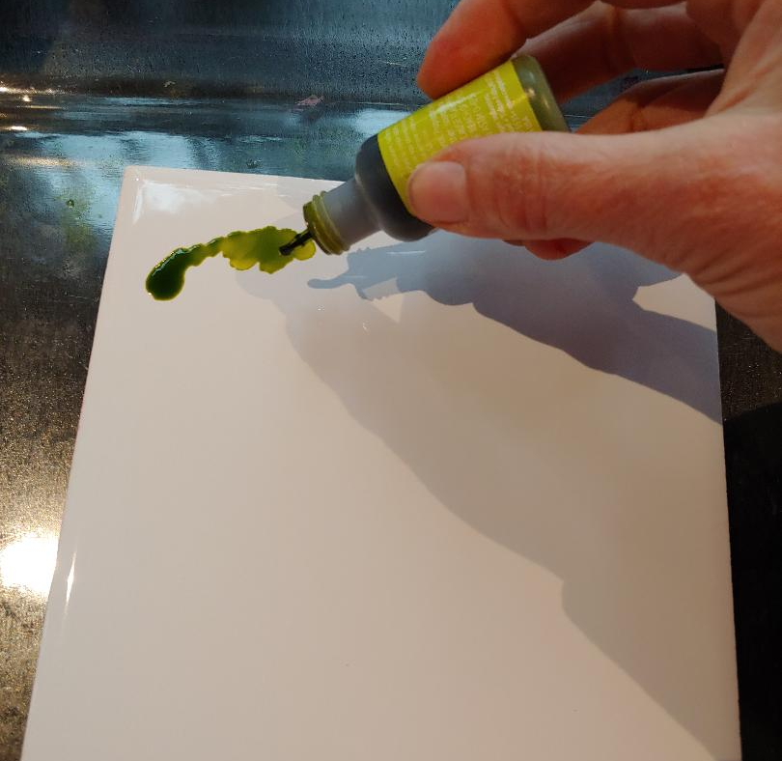
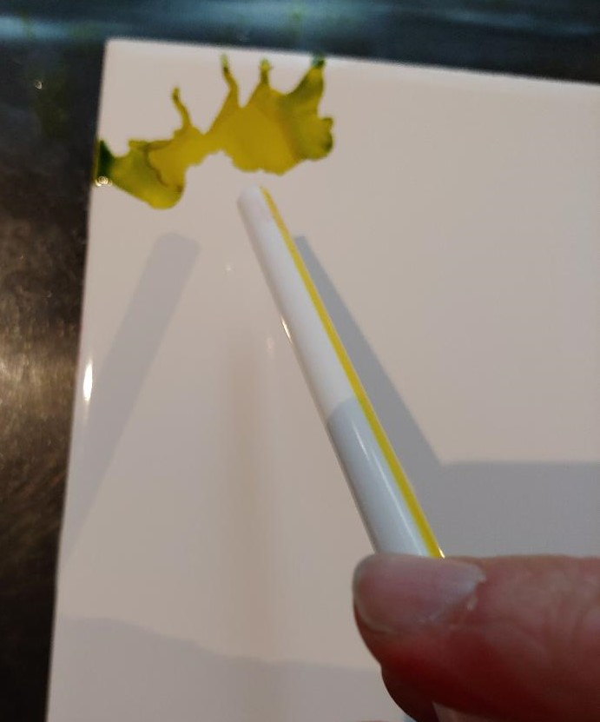
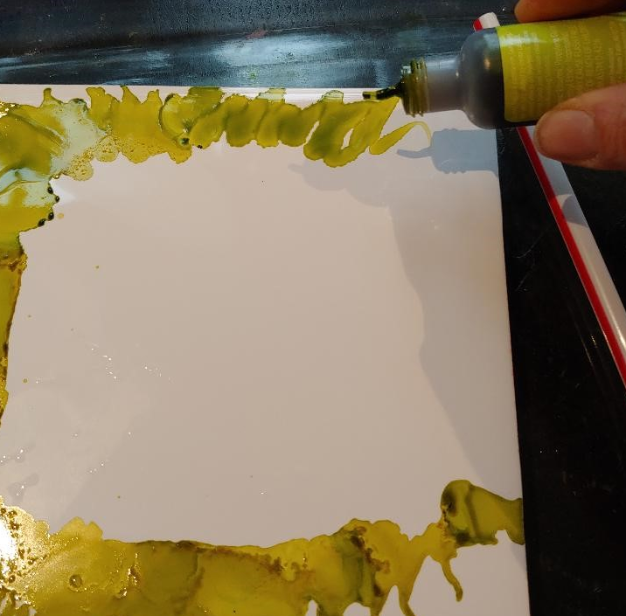
Create the Background
Make a short line with the green ink.
Quickly blow the ink toward the edges using a straw.
Continue making a green border. These are the leaves of the flower.

Slide 12
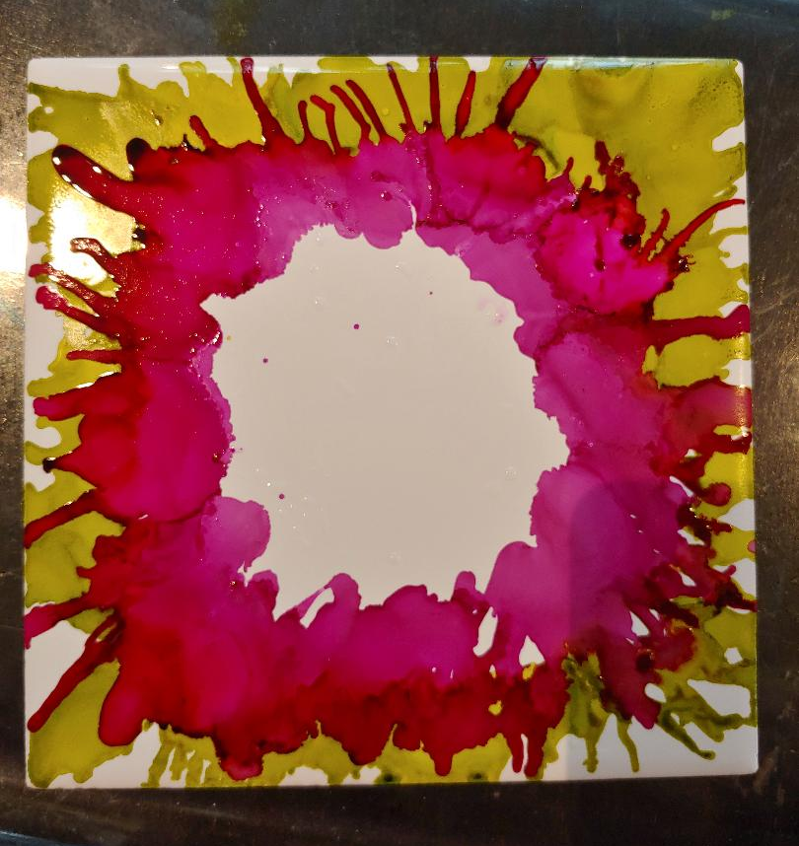
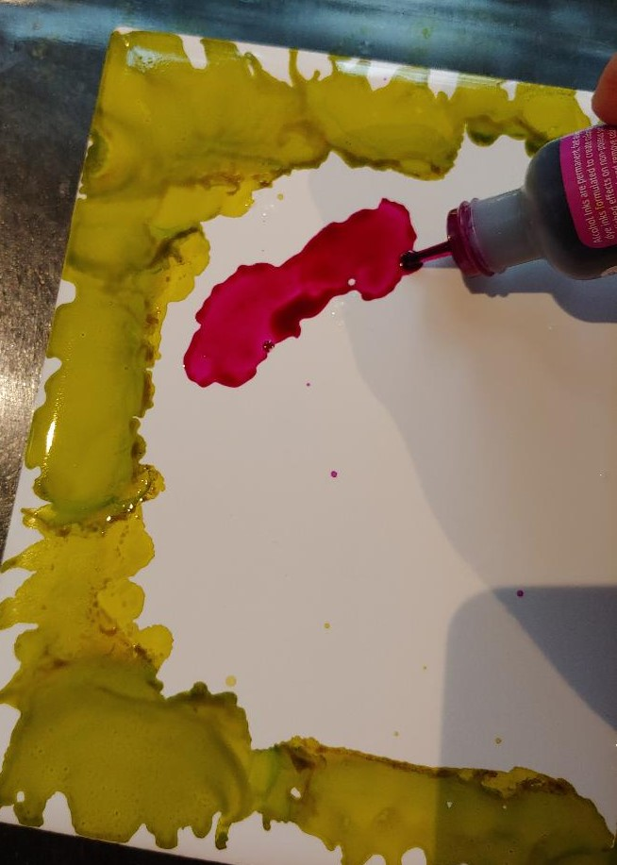
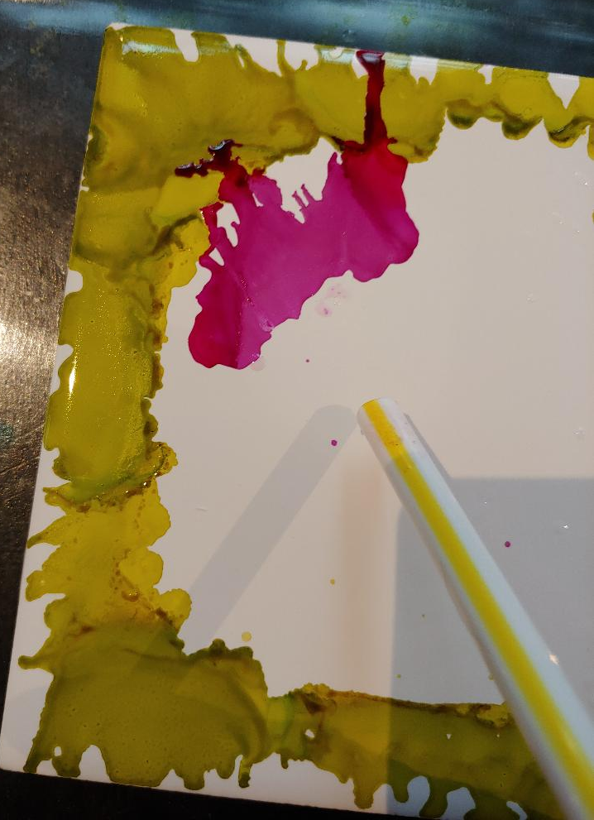
Layer Dark Value
Using your dark value color, create another line and blow with the straw.
Do this all the way around. Make sure to overlap the green a little.
Try to cover all the white.

Slide 13
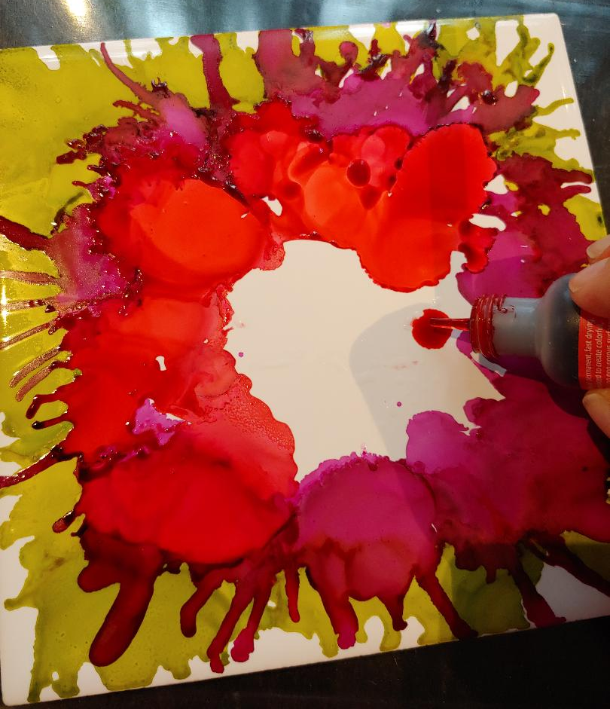
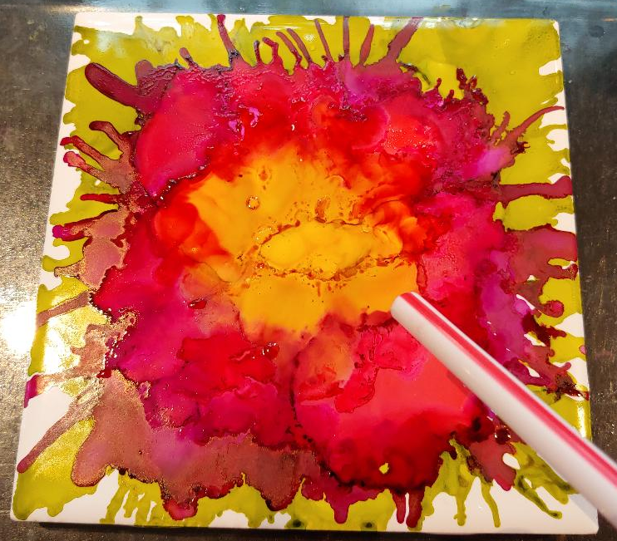
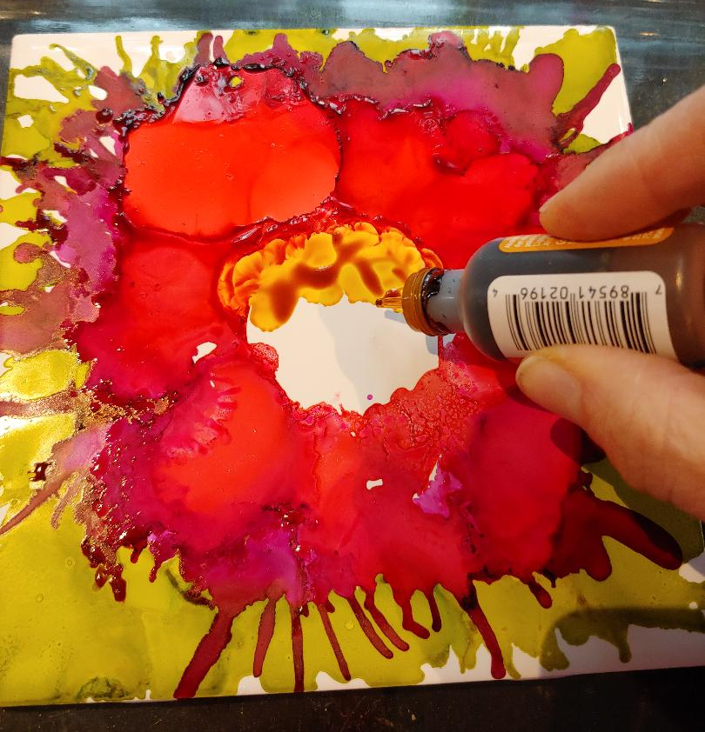
Layer Med & Light Values
Now do the same with your medium value color.
Finally, fill in the center with some drops of your light value color and blow around.

Slide 14
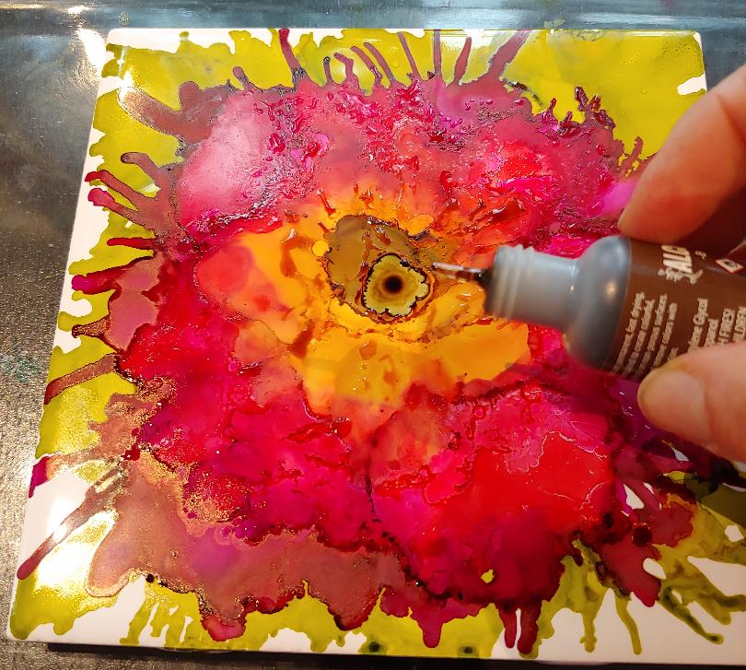
Carefully add one small drop of a dark color (brown/black) into the center.
Place tiles on designated space to dry.
A sealant will be applied so the ink doesn’t wash off and can be used as coasters.

